Slide 1
Visual Analytics Approaches for Sequential Data
Overview and Process Mining Suitability

Slide 2
Structure
Motivation and core concepts
Methodology
Results
Discussion
Questions
Visual analytics approach Sequence Synopsis

Slide 3
Motivation and core concepts

Slide 4

Process Mining
Research discipline sitting between computational intelligence and data mining
Aims to discover, monitor and improve real processes
Uses Event logs (process data) as its database
Notes:
Three process mining techniques
Discovery (Creating a process model)
Conformance (Validating a process model against the event log)
Enhancement (improving existing process models based on event log)
Übergang:
Here, process data is a subtype of sequential data.

Slide 5

What is sequential Data?
Sequential Data is „any kind of data, where order matters“
Appears basically everywhere
Special form of it is process data
„time-ordered sequences of events“
Event-tuples consist of an action, context and time
In real process environment, amount of data is too huge to be analyzed manually
Notes:
2. Appeares in many different types and forms time-series data, gene sequences, sensor data or audio clips
Übergang:
- Therefore, supporting tools are needed

Slide 6

Visual Analytics Tools
Combine “automated analysis techniques with interactive visualizations”
Help to get a better understanding of complex datasets
Visualizations can be categorized by three aspects
“Why?”, “What?” and “How?”
Notes:
Focus lies on collaborative process between human and machine
Help with exploration, similarities finding, pattern comparison or giving recommendations

Slide 7
Resulting Research Question
In process mining, visualizations are less important than mining methods
However, interactive visualizations help for a better understanding
Resulting research question:
„What are current state-of-the-art approaches in visual analytics that focus specifically on sequential data, and how are they suitable for process mining?“
Notes:
New and innovative va appraoches suitable for process mining are needed

Slide 8
Methodology

Slide 9
Methodology
Informal literature review
Focused only on paper which presented a concrete approach
Main problem was the many synonyms of sequential data
Many concrete approaches worked with spatio-temporal data
Identified 21 approaches
Created a custom coding and categorized them based on it
Notes:
Because im in my Bachelors, I conducted an informal literature review. However, I still guide myself along the formal literature review guidelines.
Therefore, i used five databases (Aisel, ASP, Ieee, ScienceDirect and Springerlink) as well as forward / backward search.
Synonyms would be temporal data, event logs, ordered data.
For spatio temporal data, also positions are important

Slide 10
Results

Slide 11
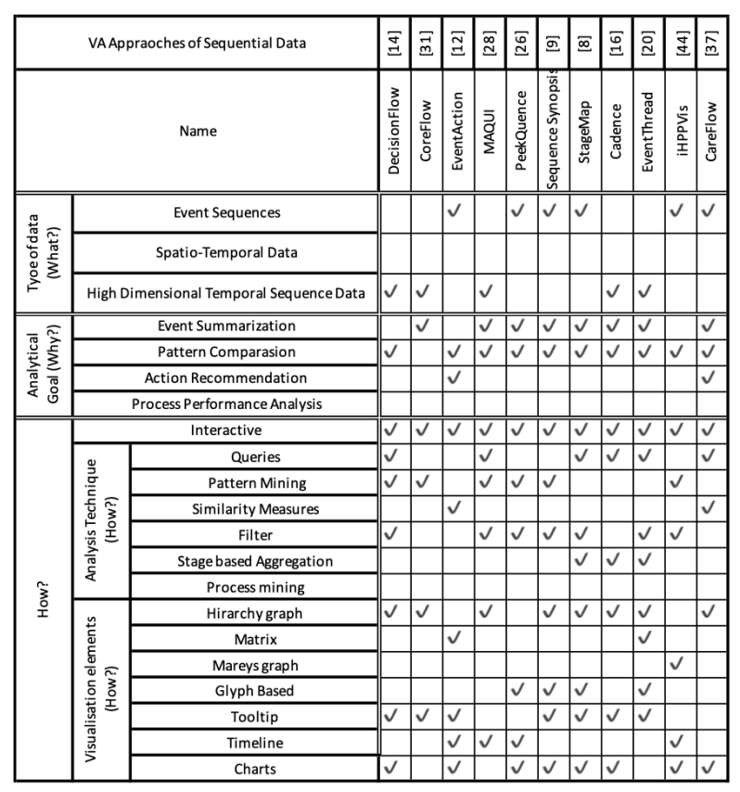
Coding
Based on the VA framework I created 4 main categories
Type of data (What?)
Analytical goal (Why?)
Analysis technique (How?)
Visualization Elements (How?)

Slide 12
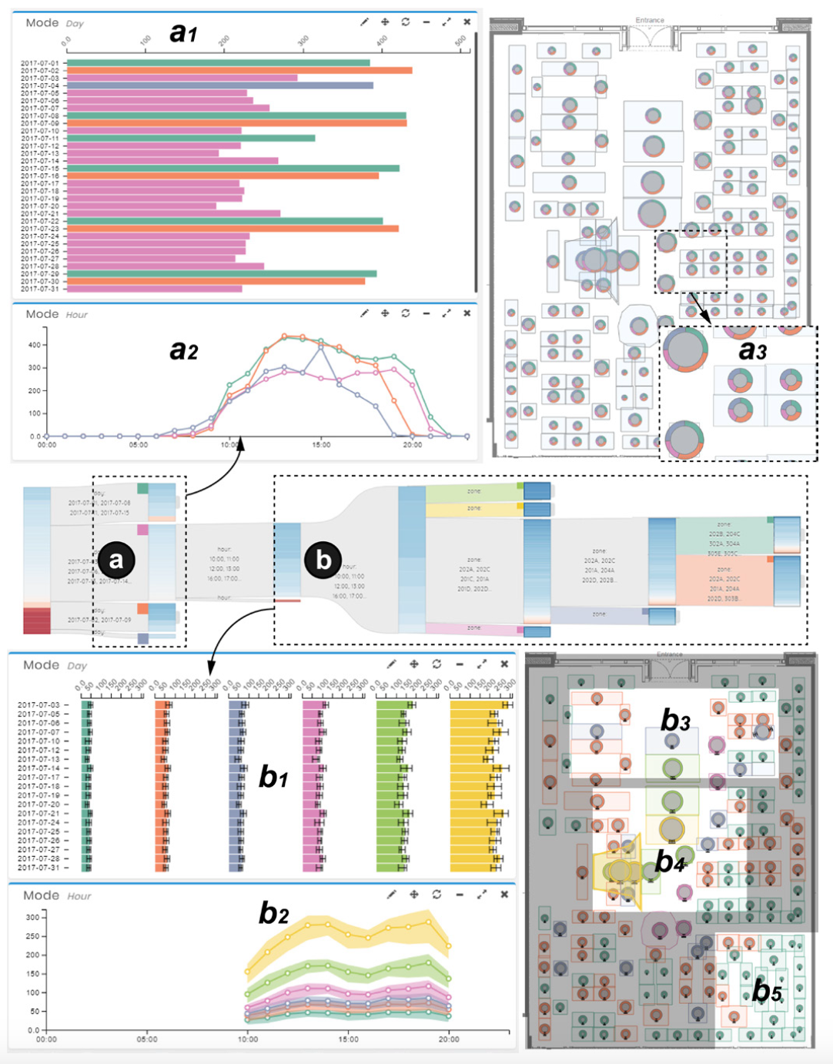
Type of data (What?)
Almost all approaches use „Event Sequences“ or „High dimensional temporal sequence data“
Difference lies in complexity of sequences
One Outlier (TPFlow) uses spatio-temporal data
Example approach TPFlow using spatio temporal data
Notes:
e.G Sequence Synopsis uses a dataset containing only 35 unique event types, which makes it easy to distinguish between those
In comparison, CoreFlow uses datasets with over 100.000 unique event types .
Decided to add TPFlow as well, because while it used spatio temporal data, it used it in a strong „corporate“ context. Meaning: It was used on a customer dataset of a retail store to analyze the customer positions inside the store over time

Slide 13
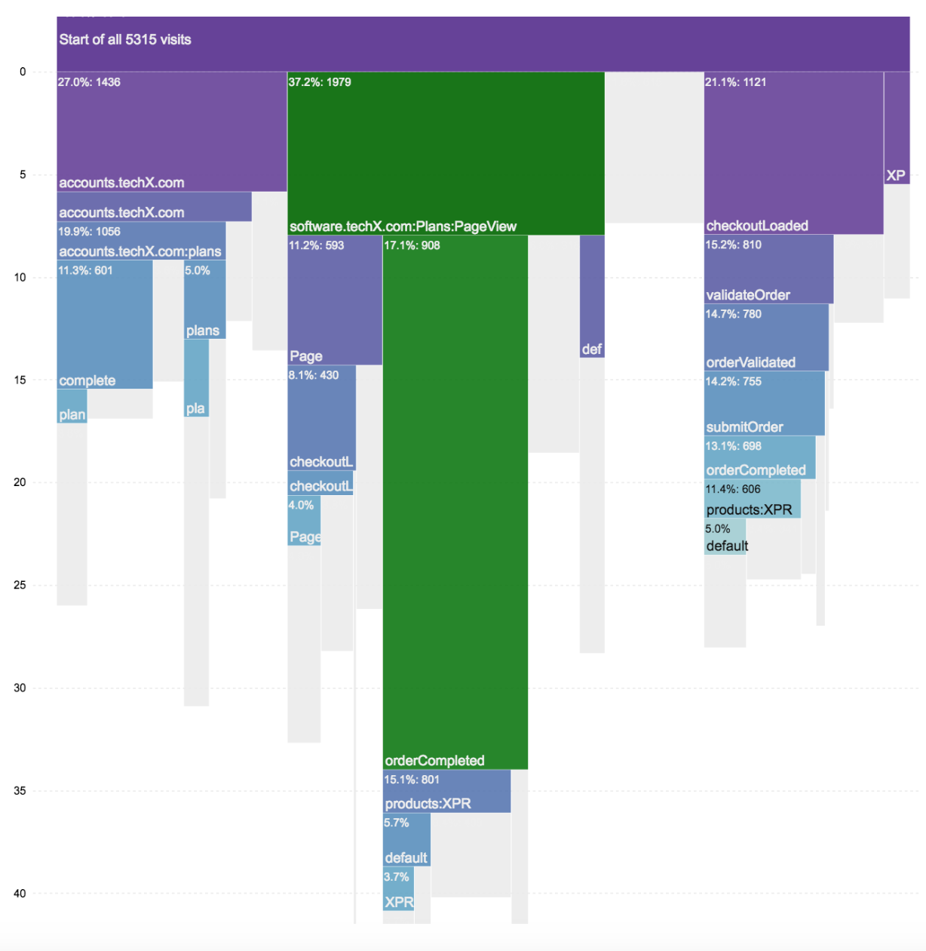
Analytical goal (Why?)
Two main goals:
Event Summarization
Pattern comparison
Additional goals:
Action recommendation
Process performance analysis
Icicle plot used in CoreFlow showing summarized event types
Notes:
Event summarization:
Goal is finding meaningful patterns and groupings of sequence entities
Helps to give analysts an overview quickly
Different summarization goals (high-level overview vs detailed one) and techniques (Sequential pattern mining, stage based aggregation)
Pattern comparison:
Directly showing different patterns or flows next to each other
Some approaches extend that to similarities finding -> tool allows for searching and presenting similar clusters or patterns
Action recommendation:
Tools give predictions and recommendations based on analysed event sequences
E.g. EventAction uses a educational dataset to give recommendations for single students to achieve their academecial goal
Process performance analysis:
Process performance is visualized to enable even more improvement

Slide 14
Analysis technique (How?)
Queries and Filters: help to select data based on certain conditions
Pattern mining: extracting meaningful patterns using algorithms and metrics
Fully automatic vs. Semi-automatic
Stage based aggregation: grouping events into stages and finding progression patterns
Notes:
Queries are usually used in for intial data preprocessing or interactive data exploration
For example, DecisionFlow uses a milestone query approach where the user specifys a ordered list of events as query constraints
Filters
Pattern Mining:
Fully automatic: mining is completly automated as a linear process
Semi-automatic: System provides mechanisms for interacting with the mining algorithm
Stage = grouping of events, progression pattern of a stage is a sequence of stages
Stage based aggregation more concise than classical pattern summarization

Slide 15
Visualization Elements (How?)

Slide 16
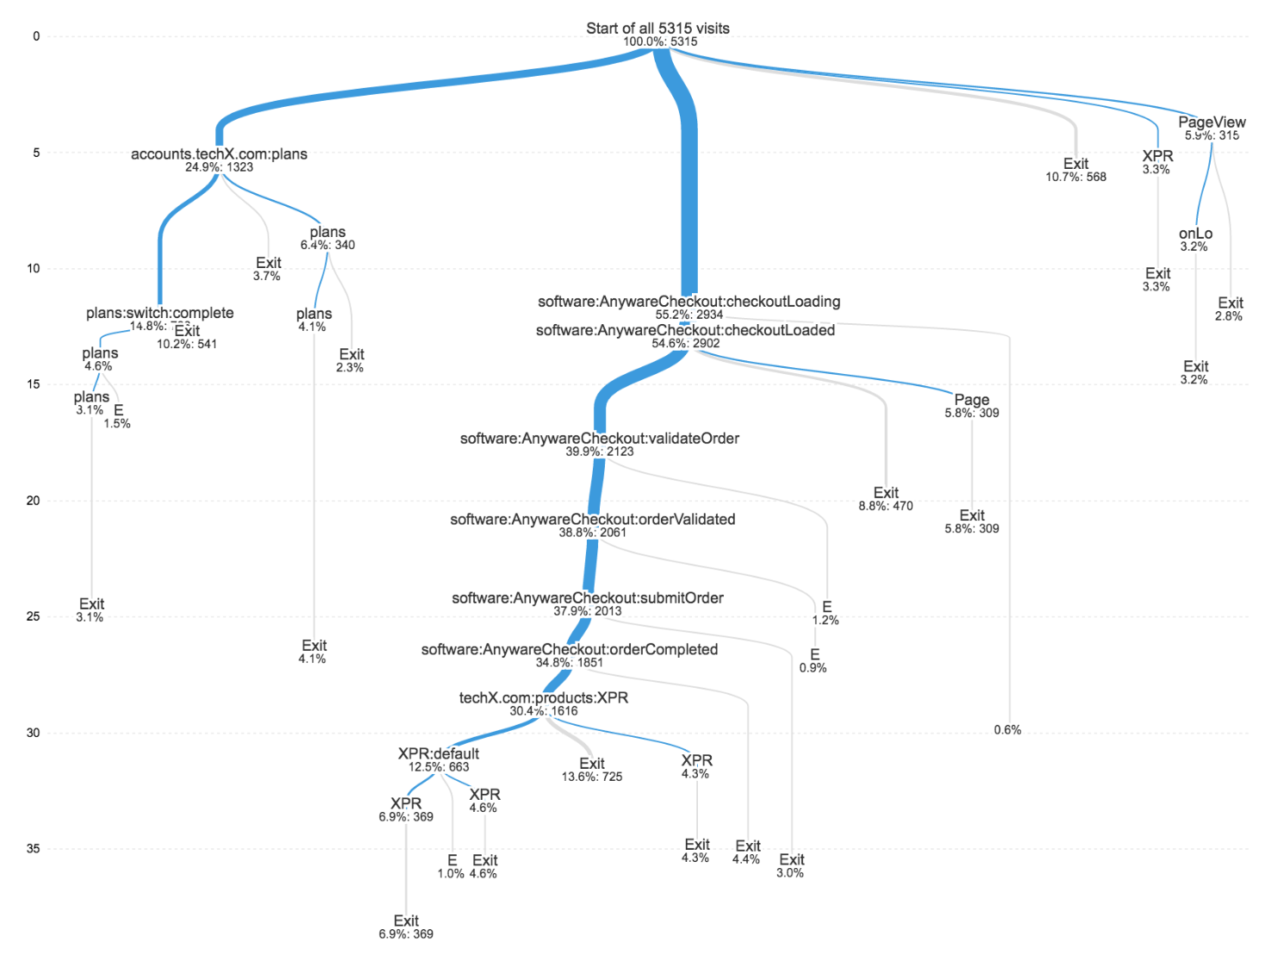
Hierarchy graphs
Sequences are aggregated in a tree of sequences
Different visualizations methods like node-link trees or icicle plots
Node-link tree used in CoreFlow

Slide 17
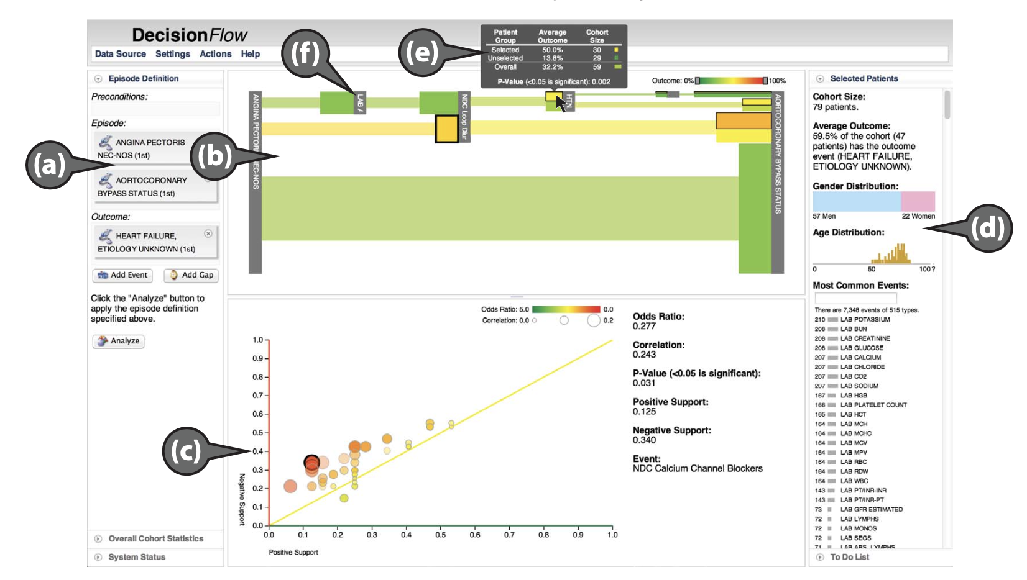
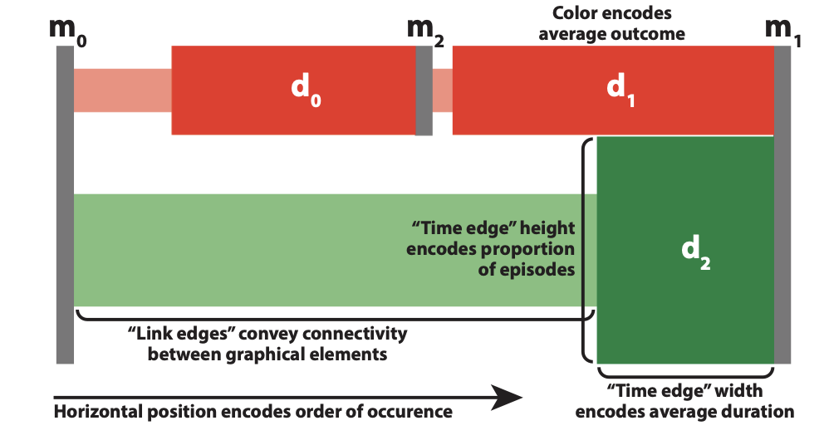
Edge concept used in DecisionFlow, Cadence and CareFlow
Hierarchy graph in DecisionFlow
Notes:
Hierarchy graph in DecisonFlow (Also used in Cadence and CareFlow)
Use this modified node-link concept, where each grey block represents a milestone and edges between two are split up into two types

Slide 18
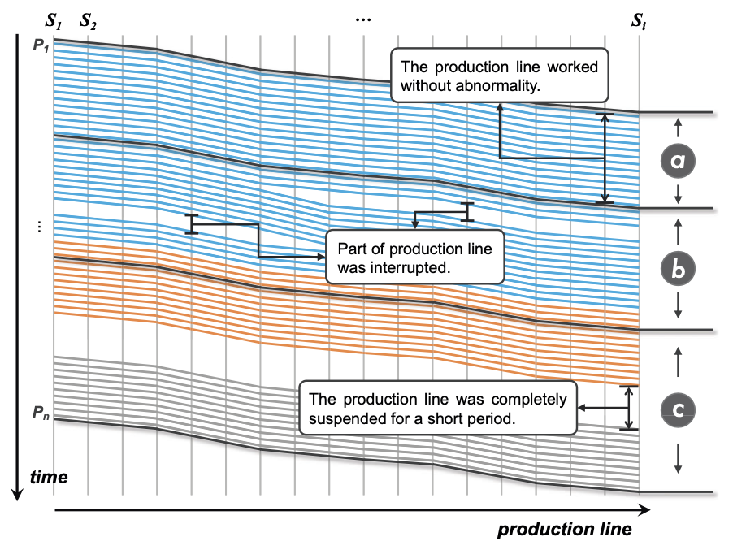
Marey‘s graph
Time axis and process axis to show process course over time
Helps to detect abnormalities, performance patterns or time deviations
Marey‘s graph used in iHPPVis showind production line interuptions
Notes:
iHPPivs/ Approach which is used in heavy plate production
Each vertical line represents a production step, angle represents time duration

Slide 19
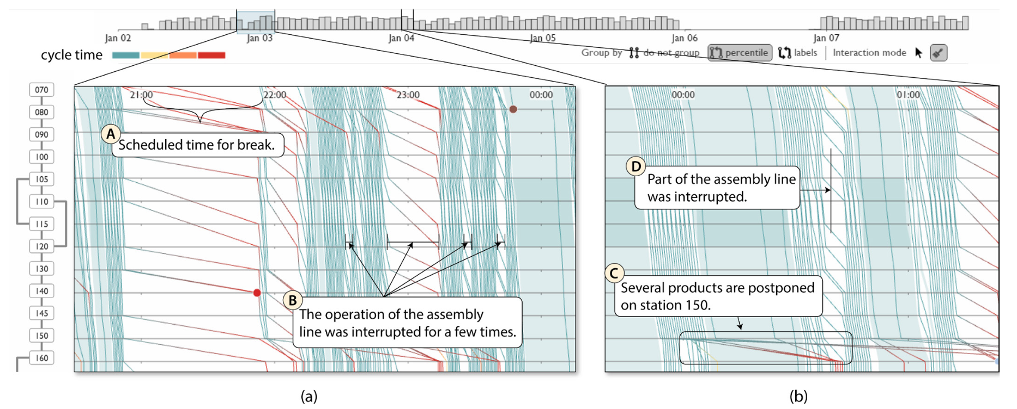
Marey‘s graph used in ViDX, showing a performance timeline and corresponding production line performance
Notes:
Another System, ViDX, which is used for production line performance.
Here you can see inconsistency early jan 03. This was because of the scheduled break.
You can also see that some products are postponed on station 150

Slide 20
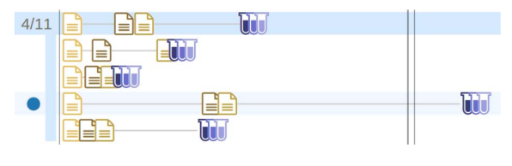
Glyph‘s
Circles or icons to represent event types
Color coding
Used to show events of each pattern or stage over time, as well as co-occurrence or frequency
Different symbols used in SepVis for displaying different event types
Notes:
Color coding can be an issue when operating with high dimensional sequence data. Therefore mostly used when only normal event sequence data is used.
Example you see SepVis, which used different symbols for displaying different event types

Slide 21
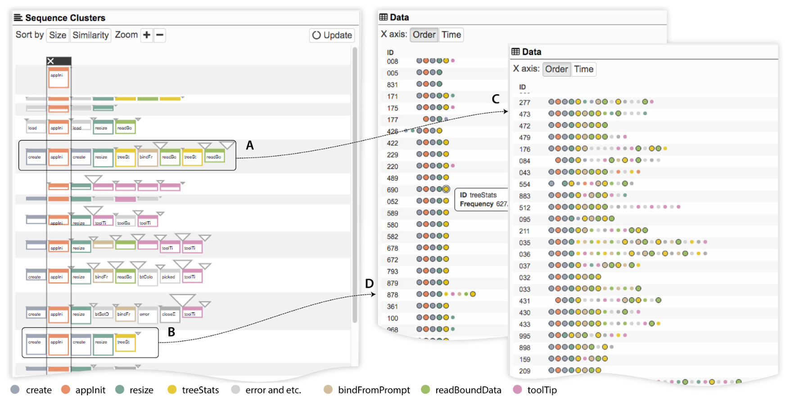
Round glyphs used in Sequence Synopsis to display different event sequences of selected pattern
Notes:
Sequence Synopsis: points are colorcoded to represent a clickstream dataset
On the left side are two patterns (A and B), where B is more homogenous than A. This can be detected both through the bigger triangles at the end of A,
where triangles stand for needed insertions, as well tough the two glyph views which significant more additional events in pattern A

Slide 22
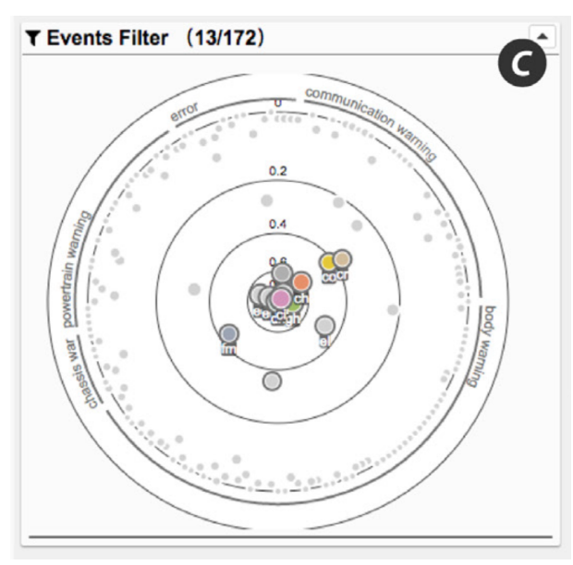
Additional Graphs
Used to show additional information
Often used are:
Bar charts
Scatter plots
Line charts
Radial scatter plot used as event filter in Sequence Synopsis
Notes:
Event filter in Vidx, where you can click on different event types for filtering

Slide 23
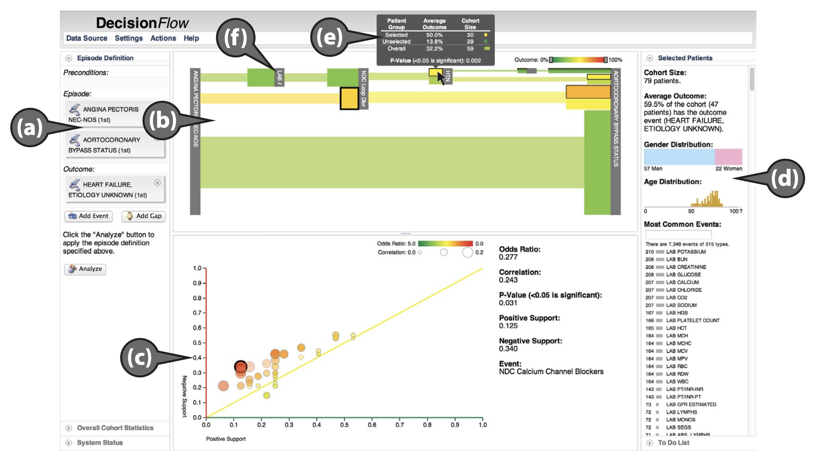
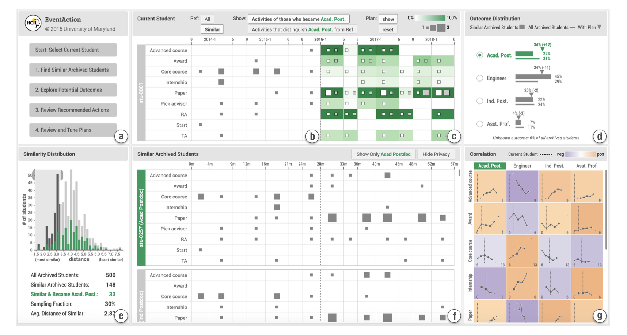
Histogram (e), Matrix elements (b, c, f) and line charts (g) used in EventAction
Correlation graphs (c), histograms (d) and tooltips (e) used in DecisionFlow
Notes:
e) Marks a tooltip in DecisionFlow,
c) Marks a correlation graph for events regarding a desired outcome
Down on the right you can also see some statistical graphs

Slide 24
Discussion

Slide 25
Interesting findings
Because of the importance of order, almost all approaches use some kind of “flow-based“ visualization
Trade-off between information loss and visual clutter
Notes:
The bigger the dataset gets, you need to simplify or aggregate to avoid a lack of clarity. However, you dont want to aggregate to much in order to safe as much information as possible.

Slide 26
Process Mining Suitability
Discovery: VA approaches can help understand complexity and variety of data
Conformance: VA approaches can help verifying that a process model actually represents the process
Enhancement: VA approaches most applicable through
Mining new and unique patterns
Breaking a process into new stages
Visualizing performance and time distribution over time
Notes:
Allow digging deep into data, offering new perspectives

Slide 27
Questions!

